Slide 1

Unit-5 Sorting and Searching
Data Structures (DS)
DU # 2304CS411
Prof. Umesh Thoriya
Department of Computer Science & Engineering
umesh.thoriya@darshan.ac.in
9714233355

Slide 2
Topics to be covered
Linear Search
Binary Search
Application of searching
Introduction of Sorting
Bubble Sort
Selection Sort
Insertion Sort
Merge Sort
Application of sorting

Looping

Slide 3
Searching
Section-1

Slide 4
Sequential / Linear Search
This is the simplest technique to search for an element from an unsorted array or list.
In this technique, search for the value of the particular element in an array or list in a sequential manner until the desired element is found.
Let us consider, the unsorted list L which contains N elements, we have to find the value of X from the list L.
L  Represent the list of elements
N  Total number of elements in a list
X  Value to be searched

Slide 5
Sequential / Linear Search
Linear Search algorithm works as below for search value, X=65.
Index
Value
k
0
22
65
0
22
0
22
0
22
22
39
39
1
39
1
39
k
1
39
65
1
65
k
65
2
65
2
65
2
2
65
65
k
45
3
45
3
45
3
45
3
45
65
4
10
4
10
4
10
4
10
0
22
39
Flag=1
1
2
65
3
45
k
10
65
4
10

Slide 6
Sequential / Linear Search
Algorithm: LINEAR_SEARCH(L, N, X)
Step 1:[initialization]
k← 1, flag ← 0
Step 2:[Perform Search]
Repeat thru step 3 for k=1,1,2,…, N
Step 3:[Compare all elements of array with given element]
if(L[k] = X) then
flag ← 1
write (“Search is successful”, temp)
Step 4:[Check for search unsuccessful]
if(flag = 0) then
write (“Search is unsuccessful”)
Step 5:[Finished]
Exit

Slide 7
Binary Search
Section - 3

Slide 8
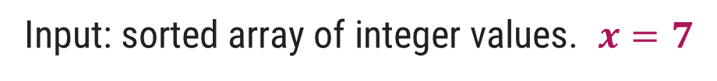
Binary Search Example
Input: sorted array of integer values. $x=7$
1 | 3 | 7 | 9 | 11 | 32 | 52 | 74 | 90
Step 1:
1 | 2 | 3 | 4 | 5 | 6 | 7 | 8 | 9
1 | 3 | 7 | 9 | 11 | 32 | 52 | 74 | 90
Find approximate midpoint

Slide 9



Binary Search Example
Step 2:
$$x=7$$
1 | 2 | 3 | 4 | 5 | 6 | 7 | 8 | 9
1 | 3 | 7 | 9 | 11 | 32 | 52 | 74 | 90
Is $7$ < midpoint value? YES.
Is $7$ = midpoint value? No.
Step 3:
1 | 2 | 3 | 4 | 5 | 6 | 7 | 8 | 9
1 | 3 | 7 | 9 | 11 | 32 | 52 | 74 | 90
Search for the target in the area before midpoint.

Slide 10

Binary Search Example
Step 4:
$$x=7$$
1 | 2 | 3 | 4 | 5 | 6 | 7 | 8 | 9
1 | 3 | 7 | 9 | 11 | 32 | 52 | 74 | 90
Find approximate midpoint
Step 5:
1 | 2 | 3 | 4 | 5 | 6 | 7 | 8 | 9
1 | 3 | 7 | 9 | 11 | 32 | 52 | 74 | 90
$7$ > value of midpoint? YES.

Slide 11
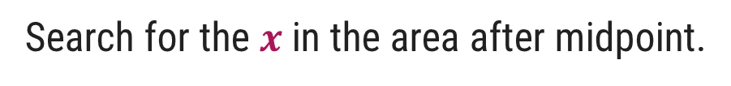
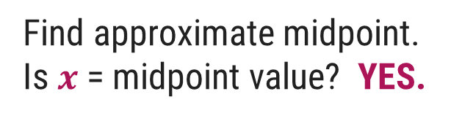
Binary Search Example
Step 6:
$$x=7$$
1 | 2 | 3 | 4 | 5 | 6 | 7 | 8 | 9
1 | 3 | 7 | 9 | 11 | 32 | 52 | 74 | 90
Search for the $x$ in the area after midpoint.
Step 7:
1 | 2 | 3 | 4 | 5 | 6 | 7 | 8 | 9
1 | 3 | 7 | 9 | 11 | 32 | 52 | 74 | 90
Find approximate midpoint.
Is $x$ = midpoint value? YES.

Slide 12
Binary Search
Binary search technique can be applied on Sorted List only and is very efficient.
It is used to find the location of a given element in a list.
If we are on the internet, information is very wide. So, linear searching is not possible to find out information about some records or files.
Linear search will take more time because searching sequentially one by one.
So, this technique works efficiently.

Slide 13
Binary Search
Steps to Perform Binary Search:
Let, low represent lower and high represent the upper limit of the list. Mid is the average of low and high.
mid = (low+high)/2
Compare the middle element with the value to be searched, if the value of the middle element is greater than the search value, then the value will exist in the lower half of the list, so take high = mid-1 and find a new value of mid by using the given equation.
Otherwise, the value will exist in the upper half of the list, so take low = mid+1 and find a new value of mid by using the given equation.
This process continues until the entire list is completed or the value is searched.
If the list is unsorted, list must be sorted first before applying binary searching technique.

Slide 14
Binary Search
Binary Search algorithm works as below for search value, X=30.
Index
List
List[mid] = List[1] = 22 ≠ X
Lower Half
0
11
List[low]
mid = (low+high)/2
X > List[mid], So low = mid+1
1
22
List[mid]
22
mid = (0+9)/2
Lower Half
2
30
List[low]
List[mid]
List[mid] = List[2] = 30 = X
30
mid = 4.5 = 4
Upper Half
3
33
List[high]
List[mid] = List[4] = 40
List[mid] = List[4] = 40 ≠ X
4
40
List[mid]
40
mid = (0+3)/2 = 1.5 = 1
X < List[mid], So high = mid-1
5
44
List[mid] = List[1] = 22
6
55
mid = (2+3)/2 = 2.5 = 2
Upper Half
7
60
List[mid] = List[2] = 30
8
66
9
77
List[high]

Slide 15
Binary Search
Algorithm: BINARY_SEARCH (List, N, X)
Step 1:[initialization]
low ← 0, high ← N-1, flag ← 0
Step 2:[Perform search]
Repeat thru step 4 while(low <= high)
Step 3:[Calculate mid]
mid ← (low+high)/2
Step 4:[Compare middle element with value to be search]
if(X < List[mid]) then
high ← mid-1
else if(X > List[mid]) then
low ← mid+1
else if(X = List[mid])
write(“search is successful”)
write(“Element no.: mid+1”)
flag ← 1
Exit
Step 5:[Check search successful or not]
if(flag = 0) then
write(“search is unsuccessful”)
Step 6:[Finished]
Exit

Slide 16

Binary Search – Examples
Write Binary Search algorithm and Demonstrate binary search algorithm to find the element $x=12$in the following array.
$$2, 5, 8, 12, 16, 23, 38, 56, 72, 91$$
Demonstrate binary search algorithm and find the element $x=31$in the following array.
$$10, 15, 18, 26, 27, 31, 38, 45, 59$$
Demonstrate binary search algorithm and find the element $x=24$in the following array.
$$12, 15, 18, 20, 27, 30, 36, 45, 54$$

Slide 17
Application of Searching
Section-4

Slide 18
Application of Searching
Information Retrieval: Searching enables quick and accurate retrieval of information from large datasets, facilitating efficient data access and reducing the time.
Sorting and Organization: Sorting and organizing data provides well-structured and efficient searching algorithms, such as binary search. It significantly reduces search time compared to linear search.
Efficient Querying: Searching operations in data structures like tree traversal enable efficient querying of elements based on specific conditions or patterns.
Database Operations: Searching is fundamental to database operations such as locating specific records, filtering data based on conditions, and generating reports.
Information Retrieval Systems: Search engines and information retrieval systems depend on efficient searching algorithms to quickly locate and retrieve relevant documents or web pages based on user queries.
Computational Efficiency: Efficient searching algorithms directly impact the computational efficiency of data structure operations.

Slide 19
Sorting
Section - 5

Slide 20
Introduction
Sorting is any process of arranging items systematically or arranging items in a sequence ordered by some criterion.
Applications of Sorting
Phone Bill: the calls made are date wise sorted.
Bank statement or Credit card Bill: transactions made are date wise sorted.
Filling forms online: “select country” drop down box will have the name of countries sorted in Alphabetical order.
Online shopping: the items can be sorted price wise, date wise or relevance wise.
Files or folders on your desktop are sorted date wise.

Slide 21
Bubble Sort
Section - 6

Slide 22
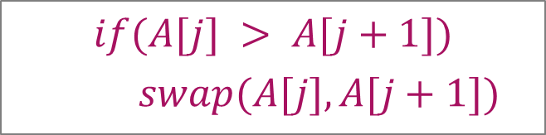
Bubble Sort – Example
Sort the following array in Ascending order
45 | 34 | 56 | 23 | 12
Pass 1 :
45
34
swap
34
34
34
34
45
45
45
45
56
56
56
23
swap
23
23
23
23
56
56
12
swap
12
12
12
12
56
$$if(A[j] > A[j+1])$$
$$swap(A[j],A[j+1])$$

Slide 23
Bubble Sort – Example
Pass 2 :
Pass 3 :
Pass 4 :
34
34
34
34
23
23
23
swap
12
swap
34
45
45
12
23
23
23
34
12
swap
swap
23
12
23
23
34
45
45
12
swap
12
34
12
12
12
45
45
45
45
56
56
56
56
56
56
$$if(A[j] > A[j+1])$$
$$swap(A[j],A[j+1])$$

Slide 24
Bubble Sort - Algorithm
# Input: Array A
# Output: Sorted array A
Algorithm: Bubble_Sort(A)
for i ← 1 to n-1 do
for j ← 1 to n-i do
if A[j] > A[j+1] then
swap(A[j], A[j+1])
temp ← A[j]
A[j] ← A[j+1]
A[j+1] ← temp

Slide 25
Selection Sort
Section - 7

Slide 26
Selection Sort – Example
Sort the following elements in Ascending order
5 | 1 | 12 | -5 | 16 | 2 | 12 | 14
Step 1 :
Unsorted Array
5 | 1 | 12 | -5 | 16 | 2 | 12 | 14
1 | 2 | 3 | 4 | 5 | 6 | 7 | 8
Step 2 :
Minj denotes the current index and Minx is the value stored at current index.
So, Minj = 1, Minx = 5
Assume that currently Minx is the smallest value.
Now find the smallest value from the remaining entire Unsorted array.
Unsorted Array (elements 2 to 8)
5
-5
1
12
-5
5
16
2
12
14
1
2
3
4
5
6
7
8
Swap
Index = 4, value = -5

Slide 27
Selection Sort – Example
Step 3 :
Unsorted Array (elements 3 to 8)
Now Minj = 2, Minx = 1
Find min value from remaining unsorted array
-5
1
1
12
5
16
2
12
14
1
2
3
4
5
6
7
8
Index = 2, value = 1
No Swapping as min value is already at right place
Step 4 :
Unsorted Array
(elements 4 to 8)
Minj = 3, Minx = 12
Find min value from remaining unsorted array
-5
1
12
2
5
16
2
12
12
14
Index = 6, value = 2
1
2
3
4
5
6
7
8
Swap

Slide 28
Selection Sort – Example
Step 5 :
Unsorted Array
(elements 5 to 8)
Now Minj = 4, Minx = 5
Find min value from remaining unsorted array
-5
1
2
5
5
16
12
12
14
1
2
3
4
5
6
7
8
Index = 4, value = 5
No Swapping as min value is already at right place
Step 6 :
Minj = 5, Minx = 16
Find min value from remaining unsorted array
Unsorted Array
(elements 6 to 8)
Index = 6, value = 12
-5
1
2
5
16
12
12
16
12
14
1
2
3
4
5
6
7
8
Swap

Slide 29
Selection Sort – Example
Step 7 :
Unsorted Array
(elements 7 to 8)
Now Minj = 6, Minx = 16
Find min value from remaining unsorted array
-5
1
2
5
12
16
12
12
16
14
1
2
3
4
5
6
7
8
Index = 7, value = 12
Swap
Step 8 :
Unsorted Array
(element 8)
Minj = 7, Minx = 16
Find min value from remaining unsorted array
-5
1
2
5
12
12
16
14
14
16
Index = 8, value = 14
1
2
3
4
5
6
7
8
Swap
The entire array is sorted now.

Slide 30
Selection Sort
Selection sort is a simple sorting algorithm.
The list is divided into two parts,
The sorted part at the left end and
The unsorted part at the right end.
Initially, the sorted part is empty and the unsorted part is the entire list.
The smallest element is selected from the unsorted array and swapped with the leftmost element, and that element becomes a part of the sorted array.
This process continues moving unsorted array boundary by one element to the right.

Slide 31
Selection Sort - Algorithm
# Input: Array A
# Output: Sorted array A
Algorithm: Selection_Sort(A)
for i ← 1 to n-1 do
minj ← i;
minx ← A[i];
for j ← i + 1 to n do
if A[j] < minx then
minj ← j;
minx ← A[j];
A[minj] ← A[i];
A[i] ← minx;

Slide 32
Insertion Sort
Section - 8

Slide 33
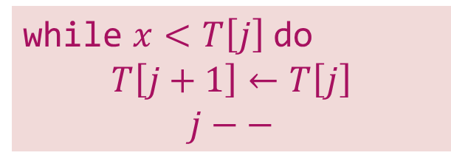



Insertion Sort – Example
Sort the following elements in Ascending order
5 | 1 | 12 | -5 | 16 | 2 | 12 | 14
Step 1 :
Unsorted Array
5 | 1 | 12 | -5 | 16 | 2 | 12 | 14
1 | 2 | 3 | 4 | 5 | 6 | 7 | 8
Step 2 :
$$j$$
$$i=2, x=1$$
$$j=i –1 and j>0$$
1
5
1
12
-5
16
2
12
14
while $x<T\left[j\right]$ do
$$T\left[j+1\right]←T\left[j\right]$$
$$j−−$$
1
2
3
4
5
6
7
8
Shift down

Slide 34

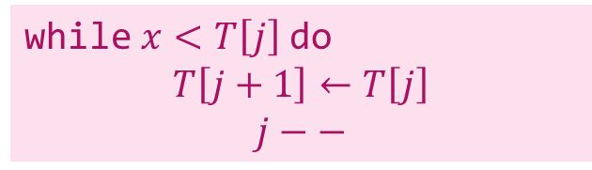


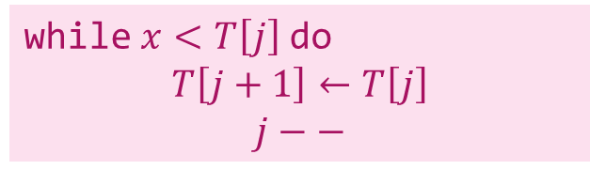




Insertion Sort – Example
Step 3 :
$$j$$
$$i=3, x=12$$
$$j=i –1 and j>0$$
1
5
12
-5
16
2
12
14
while $x<T\left[j\right]$ do
$$T\left[j+1\right]←T\left[j\right]$$
$$j−−$$
1
2
3
4
5
6
7
8
No Shift will take place
Step 4 :
$$i=4, x=−5$$
$$j=i –1 and j>0$$
$$j$$
while $x<T\left[j\right]$ do
$$T\left[j+1\right]←T\left[j\right]$$
$$j−−$$
$$j$$
-5
1
5
12
-5
16
2
12
14
1
2
3
4
5
6
7
8
Shift down
Shift down
Shift down

Slide 35




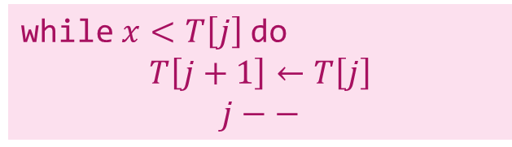


Insertion Sort – Example
Step 5 :
$$j$$
$$i=5, x=16$$
$$j=i –1 and j>0$$
-5
1
5
12
16
2
12
14
while $x<T\left[j\right]$ do
$$T\left[j+1\right]←T\left[j\right]$$
$$j−−$$
1
2
3
4
5
6
7
8
No Shift will take place
Step 6 :
$$i=6, x=2$$
$$j=i –1 and j>0$$
$$j$$
$$j$$
while $x<T\left[j\right]$ do
$$T\left[j+1\right]←T\left[j\right]$$
$$j−−$$
-5
1
2
5
12
16
2
12
14
1
2
3
4
5
6
7
8
Shift down
Shift down
Shift down

Slide 36
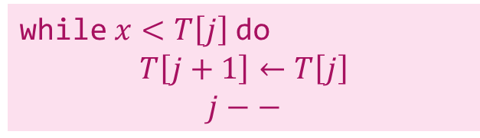






Insertion Sort – Example
Step 7 :
$$j$$
$$i=7, x=12$$
$$j=i –1 and j>0$$
-5
1
2
5
12
12
16
12
14
while $x<T\left[j\right]$ do
$$T\left[j+1\right]←T\left[j\right]$$
$$j−−$$
1
2
3
4
5
6
7
8
Shift down
Step 8 :
$$i=8, x=14$$
$$j=i –1 and j>0$$
$$j$$
while $x<T\left[j\right]$ do
$$T\left[j+1\right]←T\left[j\right]$$
$$j−−$$
-5
1
2
5
12
12
14
16
14
1
2
3
4
5
6
7
8
Shift down
The entire array is sorted now.

Slide 37
Insertion Sort
If the first few objects are already sorted, an unsorted object can be inserted in the sorted set at the proper place. This process is called Insertion Sort.
Insertion sort removes (select) one element from the input data, finds the location it belongs within the sorted list, and inserts it there.
Selected element refers as Key.
At each array position, the key checks the value against the largest value in the sorted list. If the key is larger than the largest value in the sorted list, there is no need to shift elements and move to the next element.
If the key is smaller than the largest value in the sorted list, find the appropriate position within the sorted list, shift all the larger values up to make a space, and insert into that position.

Slide 38
Insertion Sort - Algorithm
# Input: Array T
# Output: Sorted array T
Algorithm: Insertion_Sort(T[1,…,n])
for i ← 2 to n do
x ← T[i];
j ← i – 1;
while x < T[j] and j > 0 do
T[j+1] ← T[j];
j ← j – 1;
T[j+1] ← x;

Slide 39
Merge Sort
Section - 9

Slide 40
Merge Sort
Merge Sort is a divide and conquer algorithm.
Breaking down the array (list) into several sub-lists until each sub-list consists of only one element.
Compare each element with the adjacent list and merge them into one. Repeat this procedure until getting the sorted list.
Procedure:
Divide the unsorted list into N sub-lists, each containing one element.
Take the adjacent list, compare elements, and merge them to form a list of 2 elements. Now, N lists become N/2 lists of size 2.
Repeat the process until getting a single sorted list.

Slide 41
Merge Sort – Example
Unsorted Array
724 | 521 | 2 | 98 | 529 | 31 | 189 | 451
1 | 2 | 3 | 4 | 5 | 6 | 7 | 8
Step 1: Split the selected array
1
2
3
4
5
6
7
8
724
521
2
98
529
31
189
451
724
521
2
98
529
31
189
451
1
2
3
4
1
2
3
4

Slide 42
Merge Sort – Example
Select the left subarray and Split
Select the right subarray and Split
1
2
3
4
1
2
3
4
724
521
2
98
529
31
189
451
1
2
1
2
Split
1
2
1
2
724
521
2
98
529
31
189
451
1
1
1
1
1
1
1
1
724
521
2
98
529
31
189
451
521
724
2
98
31
529
189
451
Merge
2
98
521
724
31
189
451
529
2
31
98
189
451
521
529
724

Slide 43
Merge Sort – Algorithm
Procedure: mergesort(T[1,…,n])
if n is sufficiently small then insert(T)
else
array U[1,…,1+n/2],V[1,…,1+n/2]
U[1,…,n/2] ← T[1,…,n/2]
V[1,…,n/2] ← T[n/2+1,…,n]
mergesort(U[1,…,n/2])
mergesort(V[1,…,n/2])
merge(U, V, T)
Procedure: merge(U[1,…,m+1],V[1,…,n+1],T[1,…,m+n])
i ← 1;
j ← 1;
U[m+1], V[n+1] ← ∞;
for k ← 1 to m + n do
if U[i] < V[j]
then T[k] ← U[i];
i ← i + 1;
else T[k] ← V[j];
j ← j + 1;

Slide 44
Questions – Sorting Algorithm
Write an algorithm of Bubble sort and sort the following data using Bubble sort method
65, 77, 5, 25, 32, 45, 99, 83, 69, 81
12, 10, 45, 8, 19, 25, 27, 20, 44
Write an Algorithm of Selection sort and Sort the following data using Selection sort method
20, 50, 30, 75, 90, 60, 25, 10, 40
78, 17, 39, 26, 72, 94, 21, 12, 23, 68
Write an algorithm of Insertion sort and sort the following data using Insertion sort method
12, 10, 45, 8, 19, 25, 27, 20, 44
20, 50, 30, 75, 90, 60, 25, 10, 40
Write an algorithm of Merge sort and sort the following data using Merge sort method
12, 31, 25, 8, 32, 17, 40, 42
6, 5, 3, 11, 10, 4, 7, 9

Slide 45
Data Structure (DS)
DU #2304CS411
Prof. Umesh H Thoriya
Department of Computer Science & Engineering
umesh.thoriya@darshan.ac.in
9714233355

